Slide 1
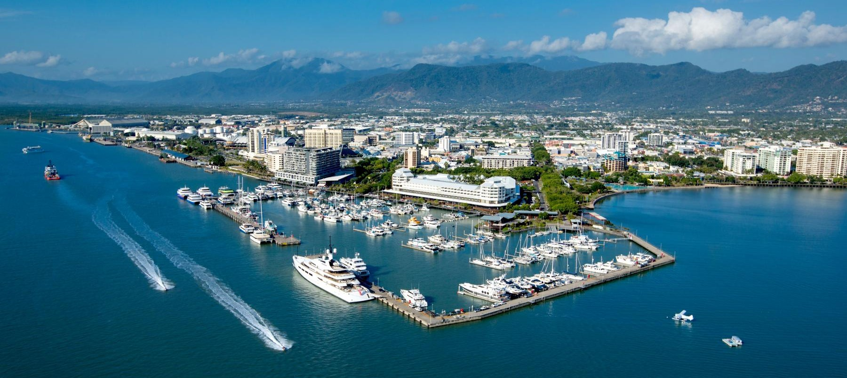
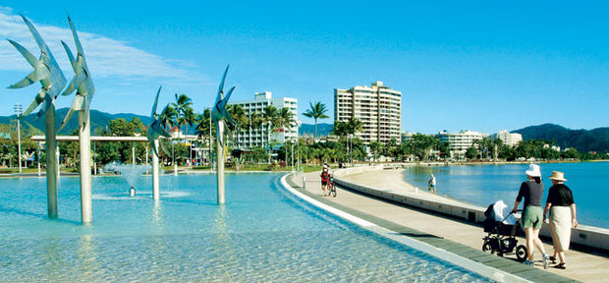
Armchair Travel To Australia
Made by Anne, Naya and Victoria

Slide 2
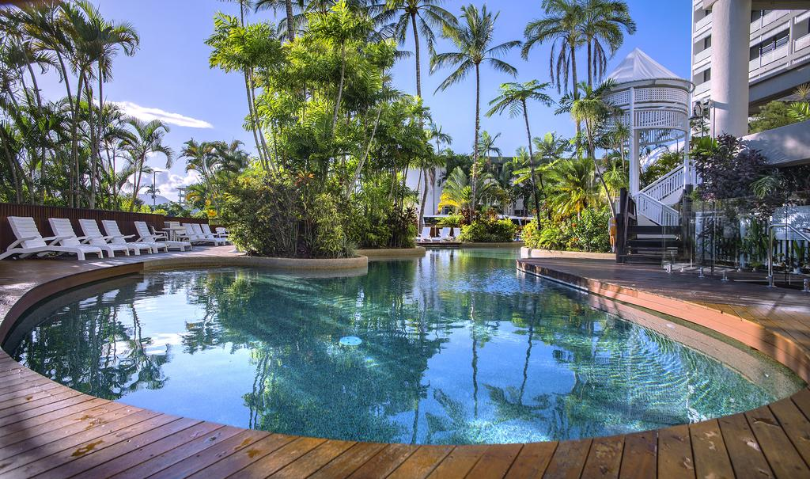
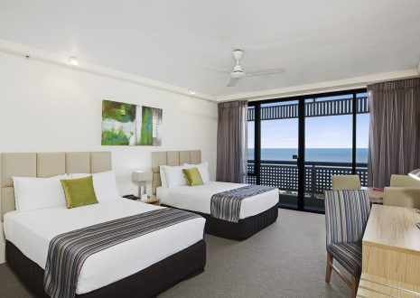
Friday 23th March
Victoria læser
We come to Australia
Rydges Esplanade Resort Cairns
DKK 5.050
There are tropical surroundings with modern style.
Each room has either a balcony or a terrace.
There is also a swimming pool.
The restaurant is open from kl. 6:00 to 10:00, and the dinner is served from 6 pm.

Slide 3
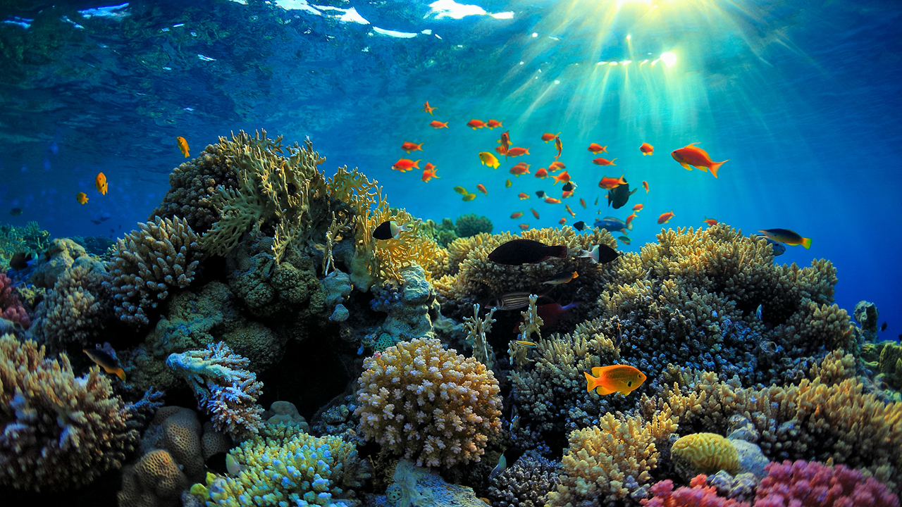
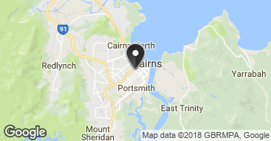
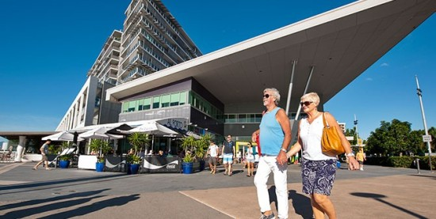
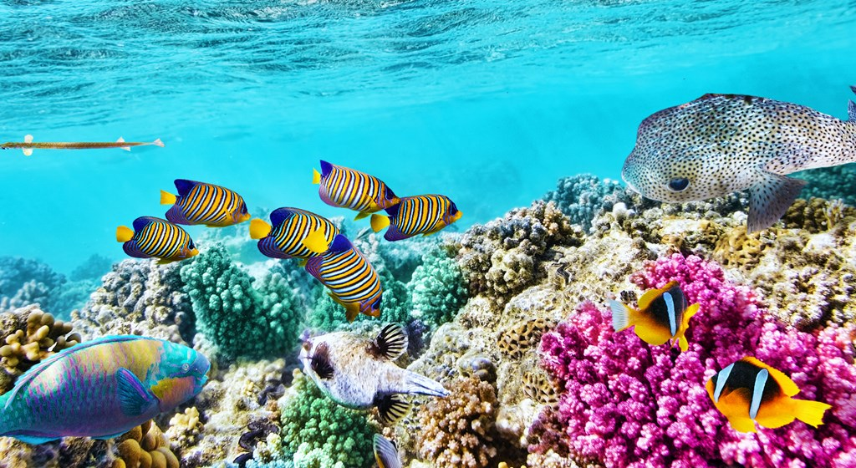
Saturday 24th March aann (
Great Barrier Reef, diving and snorkeling trip from Cairns.
5,494 Danish crowns for 1 adult and 3 kids.
Make your way to the Reef Fleet Terminal by 7:30 am and climb on board your boat with a maximum capacity of 100 people, including guides. This is a full-day tour.
Guided snorkel tour
Use of snorkel equipment Inclusions
Buffet lunch including prawns, fish, steak.
Anne læser
https://www.tripadvisor.dk/AttractionProductDetail-g255069-d3750807-a_aidSuffix.tvrm-a_partner.Viator-a_product.10986P17-Behana_Gorge_Waterfall-Cairns_Cairns_Region_Queensland

Slide 4
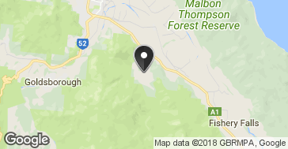
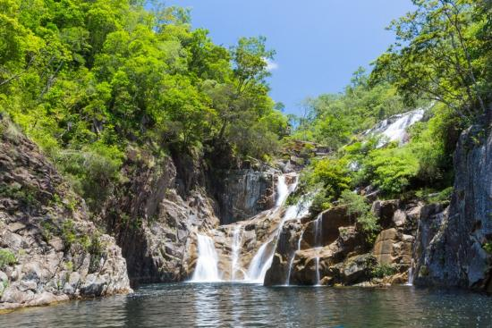
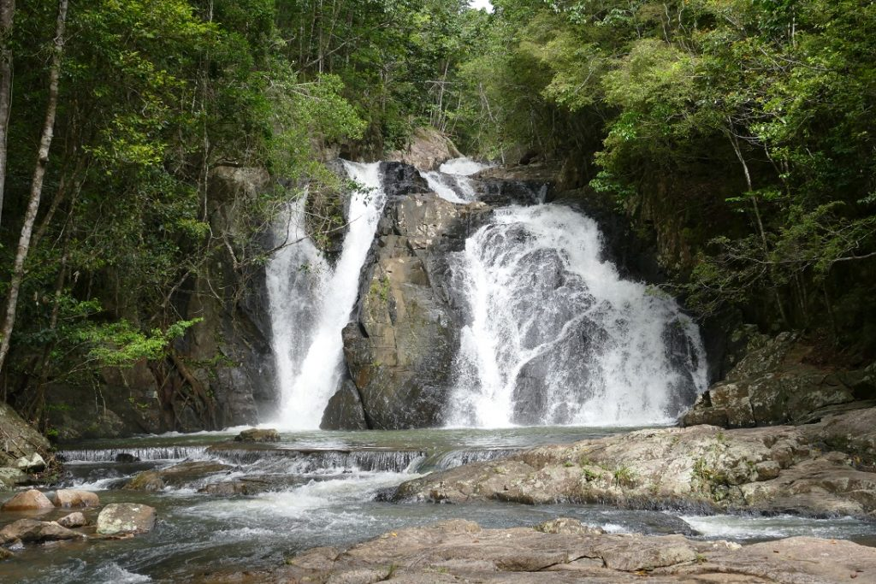
Sunday 25th March
Behana Gorge Waterfall (Cairns)
Behana Gorge Waterfall
1.212 kr. Danish crowns for 1 adult and 3 kids.
A maximum of 10 people per booking
Between 8am to 8:30pm
Inklusive
Professional local guide
All equipment provided
Lunch
All activities
Anne læser

Slide 5
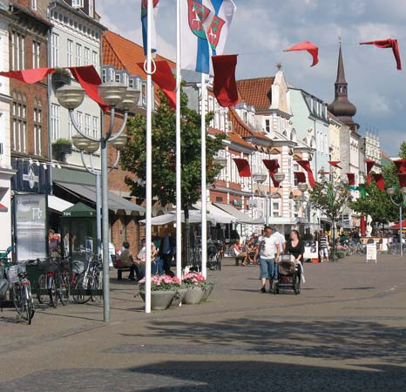
Monday 26th March
We go home from Australia
(Horsens)
Naya læser

Slide 6
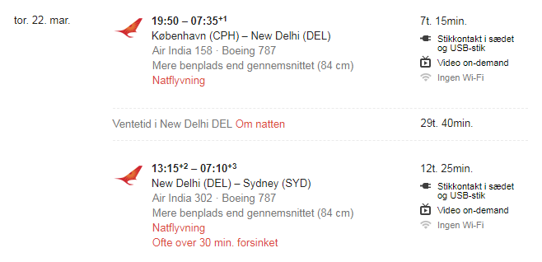
FlyveTuren Derned

Slide 7
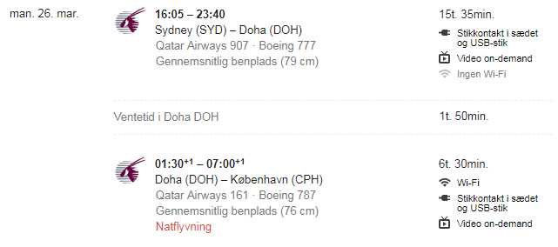
HjemTuren Hjem.

